Slide 1
Content Based Image Retrieval System
Ankit Singh - IEC2018076
Shakti Majhwar - IEC2018006
Achal Singhal - IEC2018023
Rishab Pal - IEC2081049

Slide 2
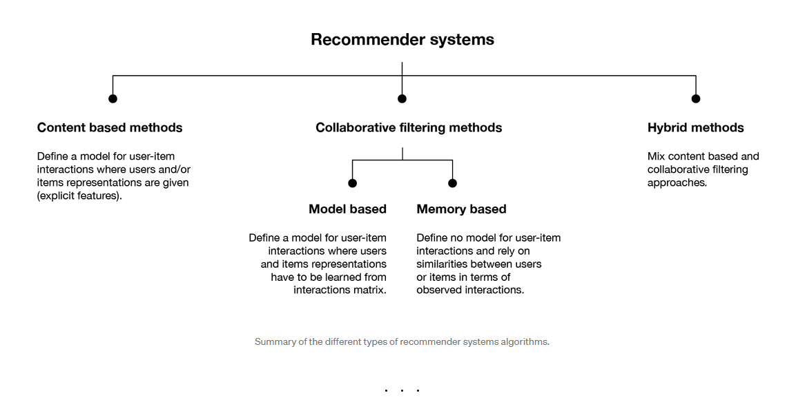

Slide 3
Content based
Unlike collaborative methods that only rely on the user-item interactions, content based approaches use additional information about users and/or items.
Then, the idea of content based methods is to try to build a model, based on the available “features”, that explain the observed user-item interactions.
Still considering users and movies, we will try, for example, to model the fact that young women tend to rate better some brands, that young men tend to rate better some other.
If we manage to get such model, then, making new predictions for a user is pretty easy: we just need to look at the profile of this user and, based on this information, to determine relevant movies to suggest.
new users or items can be described by their characteristics (content) and so relevant suggestions can be done for these new entities

Slide 4
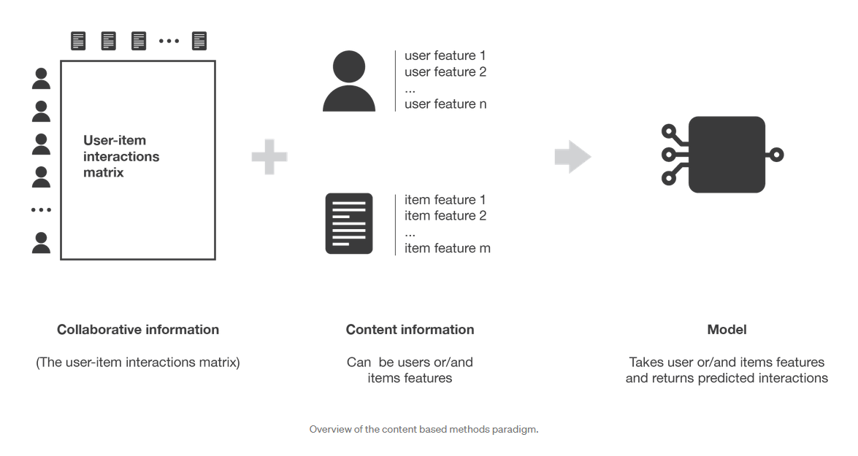

Slide 5
Introduction
Given a specific user, we would like to automatically generate a group of recommended products that are customized to what the user has viewed/bought
Product recommendations engines are a set of algorithms that personalize customers’ shopping experience by showing them products they will most likely be interested in.
The group of recommended products should be generated within few milli seconds to meet the “real-time” requirements of the pipeline.
The model should be able to adapt to new products and new users

Slide 6
Summary of Proposed Plan
The model should be able to scan across all 280K+ product images and automatically generate a group of recommended products that are customized to what the user has viewed/bought in the past.
Normalizing images and converting images to embeddings
Transfer Learning from ResNet50 and Use Fastai hooks to retrieve image embeddings
Speed is of the essence in an eCommerce firm. The group of recommended products should be generated within some milliseconds to meet the “real-time” requirements of the pipeline.
Model should automatically learn and detect the style of fashion images passed into it without further human/machine labeling.
The model should be able to adapt to new products and new users.

Slide 7
Flowchart
01
Data
Train:200 images
Validation: 40k images
Test:40k images
02
Prep
Normalize images
Convert images to embeddings
03
Model
Transfer learning from ResNet Model
Use Fastai hooks to retrieve image embeddings
04
Search
Use ANNOY to obtain most similar images
Embeddings Centroid Detection(using mean)

Slide 8
Description of Datasets
DeepFashion contains over 800,000 diverse fashion images ranging from well-posed shop images to unconstrained consumer photos, constituting the largest visual fashion analysis database.
We are only pass images into the model, the model does not ingest additional attributes/descriptions/product details
We will be using a subset of DeepFashion data open-sourced by Liu Z. et al., The Chinese University of Hong Kong.
Subset data consists of 280K fashion images across 46 categories.
The dataset consists of 1 image folder consisting of 5,621 sub-folders and 3 CSV files, consisting of information like:
• Image IDs
• Image paths in the folder
• 46 image categories mapping
• Image split into approximate 200K Train, 40K Test, and 40K Validation

Slide 9
Experimental Setup
We have dataset of 280k images, 200k for training, 40k for validating and 40k for testing.
A simpler setup involves uploading dataset to google drive and running the code in colab platform with python 3.6+ version , which provides with the appropriate GPU’s necessary for performing calculations.
Necessaries Libraries -
matplotlib
Numpy
Fastai
ANNOY
torch

Slide 10
Image Pre-processing
In the pre-processing part, first, the images are split into 3 parts: train, test, and validation as 200K, 40K, and 40K images each, with the help of information provided by DeepFashion.
Later all the images are fixed to 224x224 size, which is the default size specified by the ResNet models for best results.
Images are also normalized before dividing them into batches.
The batch size is taken to be 128, as it gives the best accuracy possible for the chosen model and dataset.
Now the dataset is ready to be fed to the ResNet models, to get trained.

Slide 11
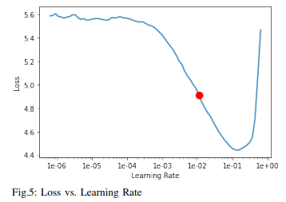
Model Training
First, the model is trained on the pre-trained model to retrieve the best learning rate for the model, using the fastai library.
The optimized learning rate came out to be 0.01(1e-2), by observing the loss vs learning rate curve.
Now the model is trained for 8 epochs and the obtained top 1 accuracy came out to be 0.664400 and the top 5 accuracy came out to be 0.926100. The total time for training is approximate 6 hours.

Slide 12
Retrieving the image embeddings
First, the model is downloaded from Gdrive and retrieved using fastai hooks.
Now the image embeddings present in the 2nd last layer of the model are retrieved, and these feature vectors(i.e., image embeddings) are concatenated to the pandas dataframe.
Now the model is ready to be fed to ANNOY(Approximate Nearest Neighbors Oh Yeah!), in order to get the recommendations.

Slide 13
ANNOY
Setting up ANNOY
Approximate nearest neighbor implementation open-sourced by Spotify, to index and search feature vectors efficiently.
It is a binary tree-based implementation of ANN.
More importantly, it helps us find closest neighbors without the need to calculate pair-wise distance across every single image.
Thus Its performs queries in O(logn)
First, the image embeddings centroids are calculated using the mean.
Now the ANNOY tree is populated, by considering 100 ntrees(the more the ntrees the better the approximation), and metric choice as “angular”.
Now the model is ready to give similar image recommendations using ANNOY.

Slide 14
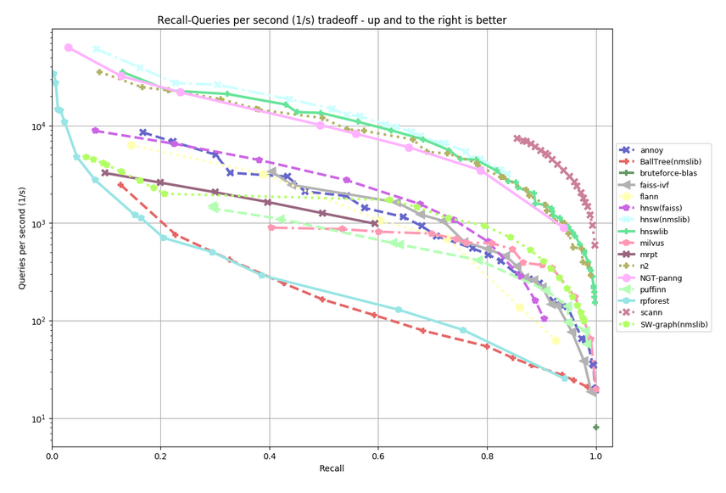
Annoy Benchmarks
Annoy was actually never built with performance in mind.
The killer feature was always to be able to load/unload indexes quickly
which no other package supports
but it's fun to see that it's actually very competitive on performance too.

Slide 15
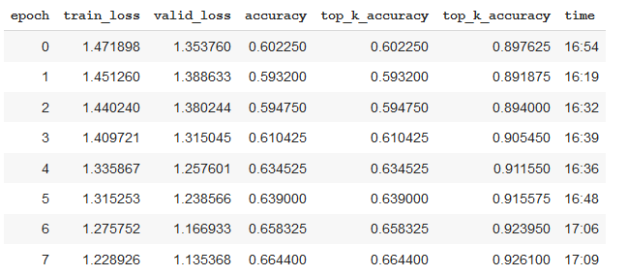
Train/Test Accuracy
We have run the model for 8 epochs
check the accuracy for k=1 and k=5 (taken mean value)
We have seen the improv- ement in accuracy after each epochs
Top accuracy is 0.9261

Slide 16
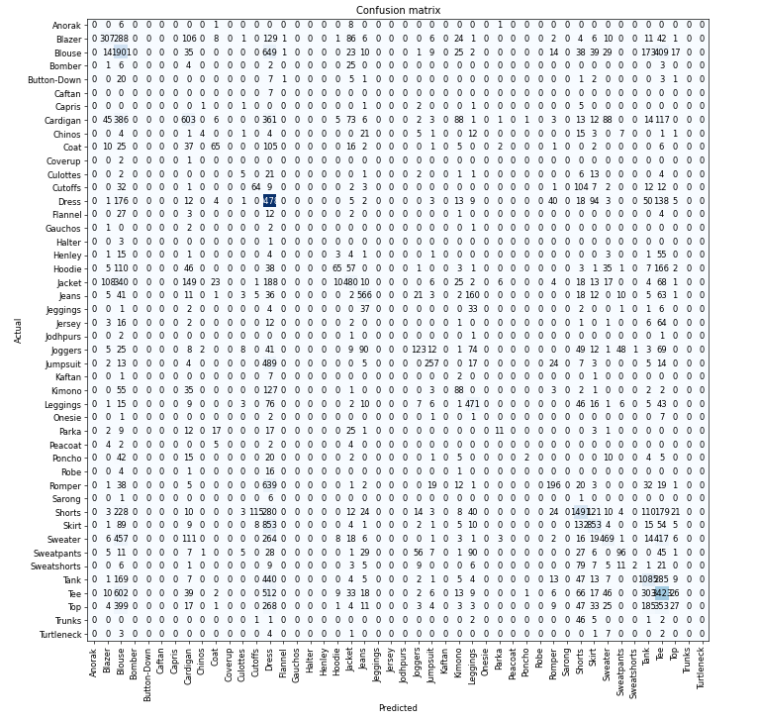
Confusion Matrix
A confusion matrix is a tabular summary of the number of correct and incorrect predictions made by a classifier.
It can be used to evaluate the performance of a classification model through the calculation of performance metrics like accuracy, precision, recall, and F1-score
x -axis represents the predicted values
y -axis represents the actual values

Slide 17
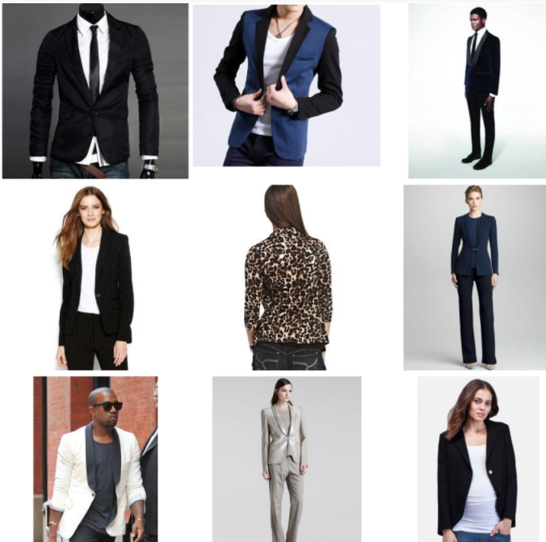
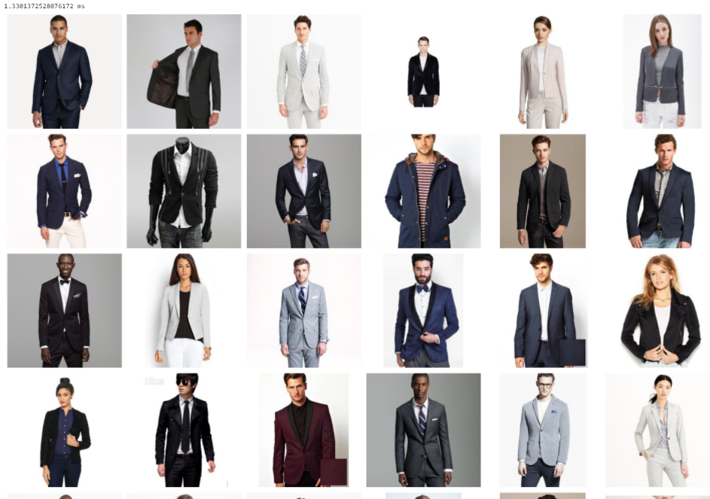
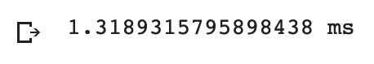
Results

Slide 18
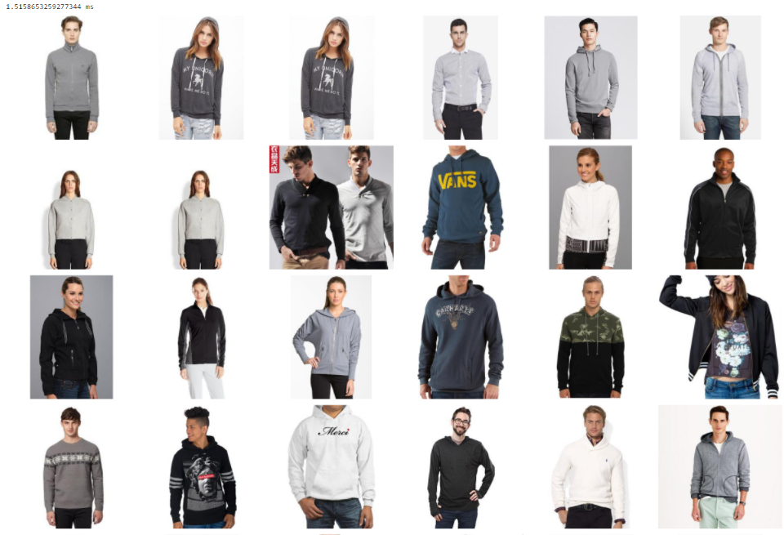
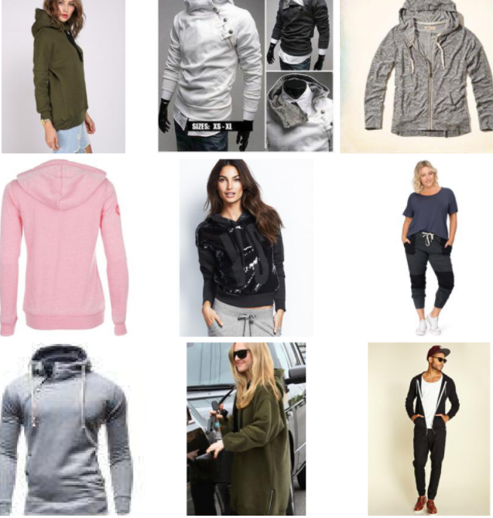

Slide 19
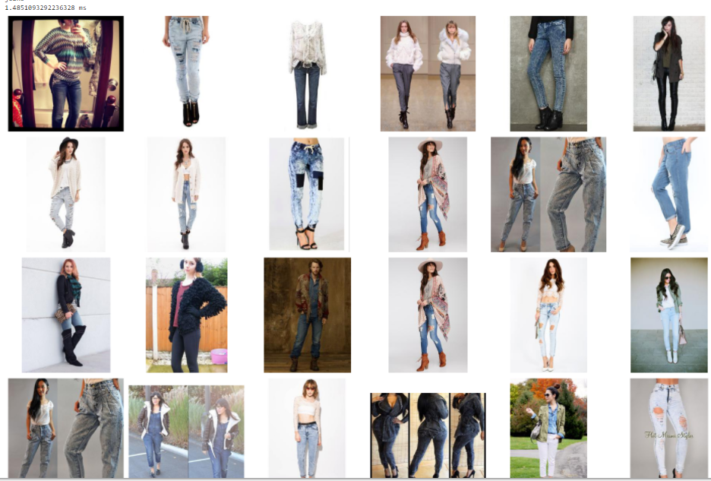
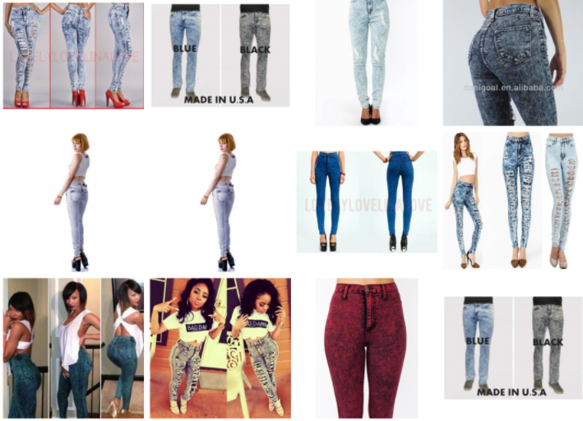

Slide 20
Conclusion
In this project, we presented the detailed analysis and implementation of Real-time personalized recommendation using ANNOY. We presented, that how extracting embeddings can drastically increase the accuracy and decrease the training and prediction time. Also using ANNOY made the prediction time as quick as a wink, i.e., in micro to milli seconds range. We further compared the traditional Clustering Algorithms with ANNOY and showed that whey ANNOY outperforms them. In the era of everything working on ML/AI, the users don’t like to wait for anything, that is what we achieved in this project

Slide 21
References:-
Liu, Ziwei and Luo, Ping and Qiu, Shi and Wang, Xiaogang and Tang, Xiaoou, “DeepFashion: Powering Robust Clothes Recognition and Retrieval with Rich Annotations”, Proceedings of IEEE Conference on Computer Vision and Pattern Recognition (CVPR), June 2016
N. N. Qomariyah and A. N. Fajar, ”Recommender System for e-Learning based on Personal Learning Style,” 2019 International Seminar on Research of Information Technology and Intelligent Systems (ISRITI), 2019, pp. 563-567, doi: 10.1109/ISRITI48646.2019.9034568.
Y. Park, ”Recommending Personalized Search Terms for Assisting Exploratory Website Search,” 2019 ACM/IEEE Joint Conference on Digital Libraries (JCDL), 2019, pp. 404-405, doi: 10.1109/JCDL.2019.00091.
A. Bodaghi and E. Homayounvala, ”Personalization of interactive recommender systems for expert users,” 2018 4th International Conference on Web Research (ICWR), 2018, pp. 58-62, doi: 10.1109/ICWR.2018.8387238.
Zeyuan Allen-Zhu, Yuanzhi Li, “What Can ResNet Learn Efficiently, Going Beyond Kernels?”, 1 June 2021

Slide 22
Erik Bernhardsson, “Nearest neighbors and vector models – part 2 – algorithms and data structures”, 01-10-2015[Online], Available: https://erikbern.com/2015/10/01/nearest-neighborsand-vector-models-part-2-how-to-search-in-highdimensional-spaces.html [Accessed on: 15-09-2021]
Abhigya Sodani, Michael Levy, Anirudh Koul, Meher Anand Kasam, Siddha Ganju, “Scalable Reverse Image Search Engine for NASAWorldview”, 10 Aug 2021
Trieu H. Trinh, Minh-Thang Luong, Quoc V. Le, “Selfie: Self-supervised Pretraining for Image Embedding”, 27 Jul 2019
Will Koehrsen, “Transfer Learning with Convolutional Neural Networks in PyTorch”[Online], 27-11-2018, Available: https://towardsdatascience.com/transferlearning-with-convolutional-neural-networks-in-pytorchdd09190245ce [Accessed on: 18-10-2021]
Rinu Gour, “Transfer Learning for Deep Learning with CNN”, [Online], 28-11-2018, Available: https://medium.com/@rinu.gour123/transfer-learningfor-deep-learning-with-cnn-afa1fe0aa7e2 [Accessed on: 25-10-2021]

Slide 23
THANK YOU

